Slide 1

YZY Language School
Ying HAO
Yaowu HUANG
Zhiwei LI
APR 19, 2021

Slide 2

Agenda - Purpose of the System - Solution Overview - Challenges of the project - MVVM Architecture - Multiple Validations - Unit Test - UI Design - Drawing pie chart / bar chart - String Translation - Database Migration - Future Work

Slide 3
Purpose of the System - Multi-Language Support: English, French, Mandarin - Register/Cancel Courses - Manage assignment and grade - Search by key-words/time/language: course, teacher - Course Time: day or night of weekdays, weekends, summer camp, etc. - Course Type: small class, one-to-one class, on-line class, etc. - Payment Modules - Student Application - register courses, cancel courses, payment - School Application - Teacher (course time, assignment, grade) - Library - all common shared functionalities

Slide 4
Solution - Student Application - register courses, cancel courses, payment - School Application - Teacher (course time, assignment, grade) - Library - all common shared functionalities

Slide 5
Challenges in the first Client-Server Project
Bulk Data needs migration from local database to Azure
Database Design has to be altered for coding convenience
Database Validation conflicts with the one of Code Side
How to split coding work independently between members
How to write Unit Test cases without UI input
How to make a modern UI instead of homework style
Performance need further optimization
How to integrate JS Payment Gateway with WPF desktop App

Slide 6
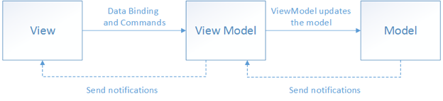
MVVM Architecture – Why?
Model (data layer) – View Model (logic layer) – View (user interface)
View is built on XAML only.
View model encapsulates the model.
View links with View Model via data binding and command binding.
The UI can be redesigned without touching the code (logic and data layers).
Unit tests can be built for the code (logic and data layers), without using UI.
Designers and developers can work independently.

Slide 7
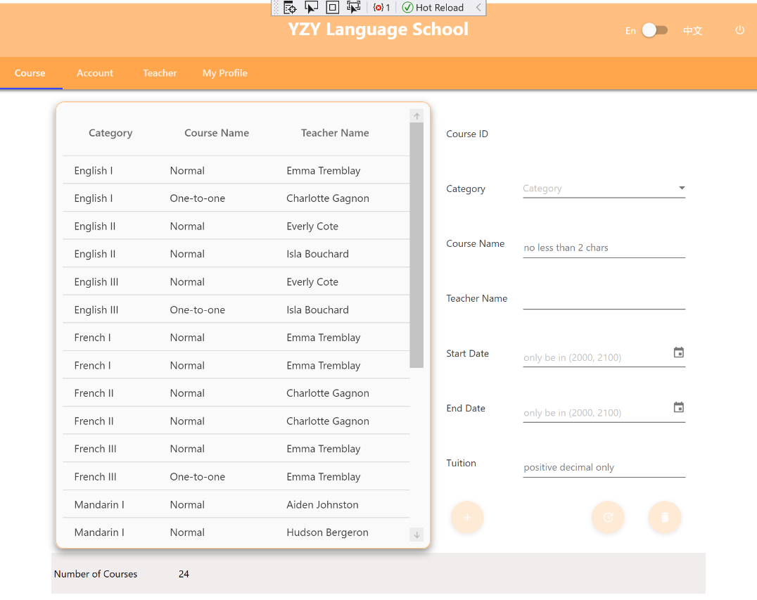
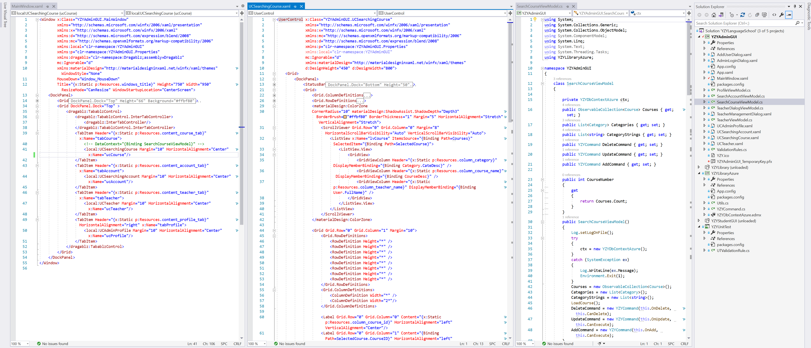
MVVM Architecture – Code Example

Slide 8
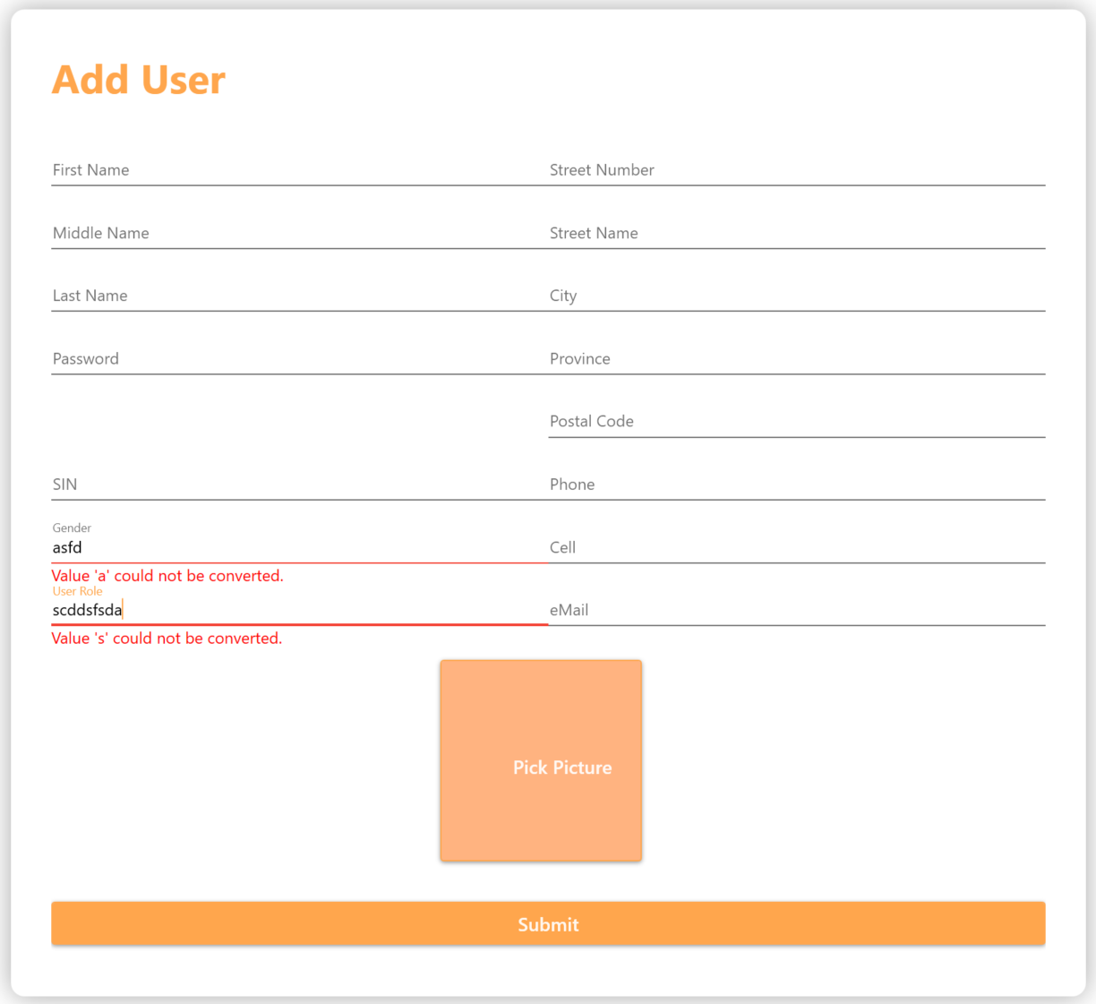

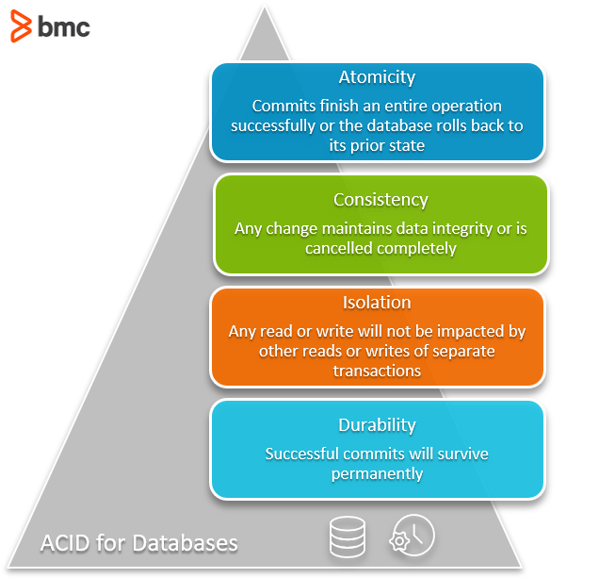
Multiple Validations
Hint information
IDataErrorInfo
Message
Exception
ValidatesOnDataErrors
Business Logic Validation
Data Format Validation
ACID

Slide 9

User Interface
User Controls / tab, Responsive,
Animation Effect,
Charts

Slide 10
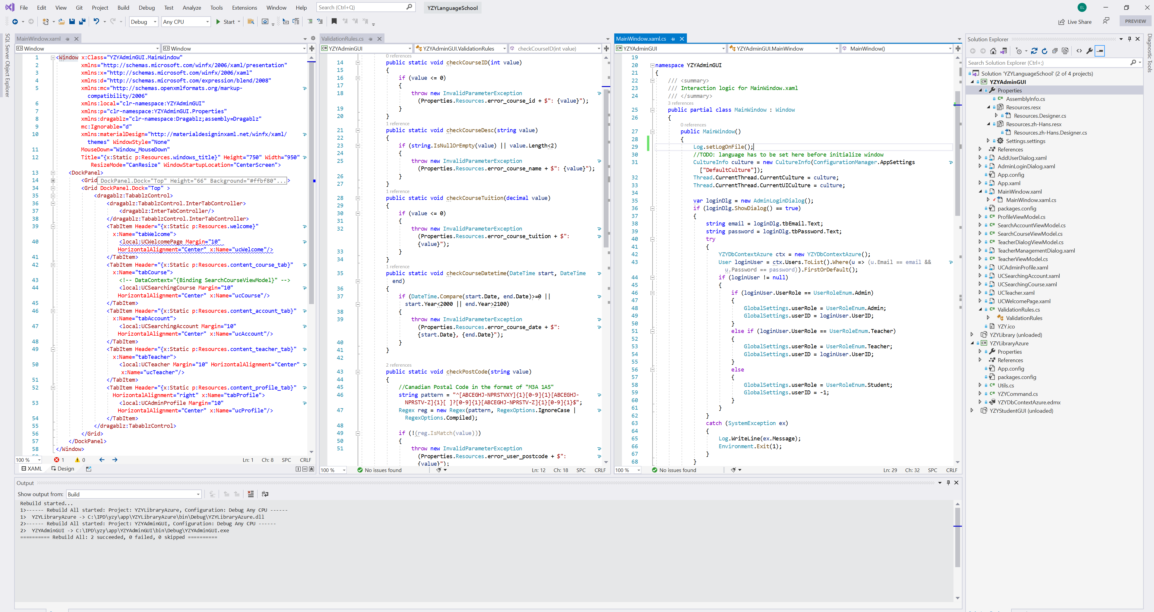
String Translation
Use translation resources in XAML
Use translation resources in c# code
Set language culture (configuration) before InitializeComponent()
Resources in Properties

Slide 11
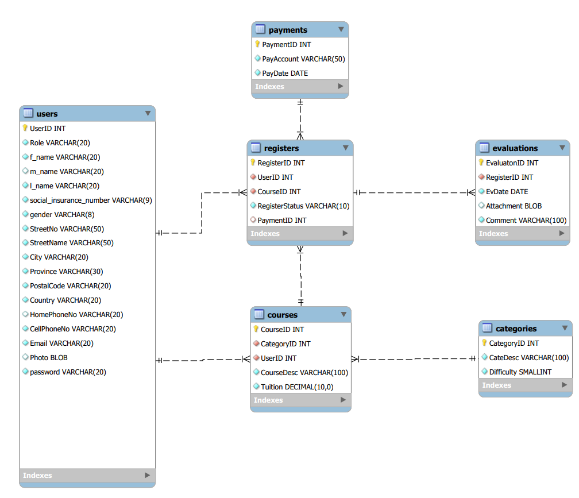
Database Migration

Slide 12
Future Work
Performance need further optimization
How to integrate JS Payment Gateway with WPF desktop App

Slide 13
Summary
…

Slide 14
Thank You! Merci! 谢谢！

